Slide 1
Idea del Kernel SVM

Slide 2
SVM separa bien estos puntos
x2
x1

Slide 3
¿Y estos puntos?
x2
x1

Slide 4
¿Y estos puntos?
x2
x1
Notes:
Nope

Slide 5
¿Y estos puntos?
x2
x1
Notes:
Nope

Slide 6
¿Y estos puntos?
x2
x1
Notes:
Nope

Slide 7
¿Y estos puntos?
x2
x1
Notes:
Nope

Slide 8
¿Y estos puntos?
x2
?
x1

Slide 9
¿Por qué no funciona?
Porque esta nube de puntos no es LINEALMENTE SEPARABLE

Slide 10
Linealmente Separable
Linealmente Separable
No Linealmente Separable
x2
x2
x1
x1
Notes:
Transformando a una Dimensión Superioral Space in which the data is Linearly Separable

Slide 11
Espacios de Dimensión Superior

Slide 12
Transformando a una Dimensión Superior
f = x - 5
0
x1

Slide 13
Transformando a una Dimensión Superior
f = x - 5
f = (x – 5)^2
0
x1

Slide 14
Transformando a una Dimensión Superior
f = x - 5
f = (x – 5)^2
0
x1

Slide 15
Transformando a una Dimensión Superior
Espacio 2D
x2
x1

Slide 16
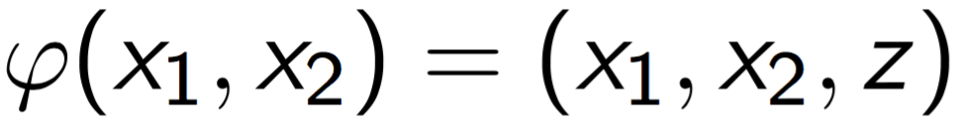
Transformando a una Dimensión Superior
Espacio 2D
x2
Función de Transformación
x1
Notes:
We apply the Función de Transformación...

Slide 17
Transformando a una Dimensión Superior
z
Espacio 3D
Espacio 2D
x2
Función de Transformación
x2
x1
x1
Notes:
... to transform the data points into Higher Dimensional Space.

Slide 18
Transformando a una Dimensión Superior
Nueva Dimensión
z
Espacio 3D
Espacio 2D
x2
Hiperplano
Función de Transformación
x2
x1
x1

Slide 19
Proyectando de vuelta al espacio 2D
z
Espacio 3D
x2
x1

Slide 20
Proyectando de vuelta al espacio 2D
z
Espacio 3D
Proyección
x2
x1

Slide 21
Proyectando de vuelta al espacio 2D
Espacio 2D
z
Espacio 3D
x2
Proyección
x2
x1
x1

Slide 22
Proyectando de vuelta al espacio 2D
z
x2
Espacio 2D
Espacio 3D
Separador No Lineal
Proyección
x2
x1
x1
Notes:
Say that this new separator obtained by the Proyección is a non linear separator here in 2D, but was a Hiperplano linear separator back in 3D.

Slide 23
Pero hay un precio a pagar…
Transformar una variable a un Espacio de Dimension Superior puede ser muy costoso computacionalmente

Slide 24
El truco del Kernel
Notes:
landmarks

Slide 25
El Kernel Gaussiano RBF
$$K\left(\overset{→}{x},{\overset{→}{l}}^{i}\right)=e^{−\frac{{\left\|\overset{→}{x}−{\overset{→}{l}}^{i}\right\|}^{2}}{2σ^{2}}}$$
Notes:
Just give this Kernel as an example and say that this is the most popular Kernel and this is the one we are going to use in the R & Python applications.
Maybe precise that x^i and x^j are some data points and not coordinates.
https://www.youtube.com/watch?v=HwQQXs4Nyjo
https://www.youtube.com/watch?v=LHzqW0EolzE
https://www.youtube.com/watch?v=OmTu0fqUsQk

Slide 26
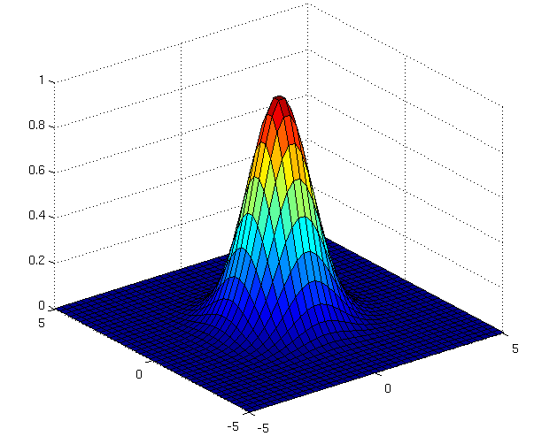
El Kernel Gaussiano RBF
$$K\left(\overset{→}{x},{\overset{→}{l}}^{i}\right)=e^{−\frac{{\left\|\overset{→}{x}−{\overset{→}{l}}^{i}\right\|}^{2}}{2σ^{2}}}$$
Image source: http://www.cs.toronto.edu/~duvenaud/cookbook/index.html
Notes:
Just give this Kernel as an example and say that this is the most popular Kernel and this is the one we are going to use in the R & Python applications.
Maybe precise that x^i and x^j are some data points and not coordinates.
https://www.youtube.com/watch?v=HwQQXs4Nyjo
https://www.youtube.com/watch?v=LHzqW0EolzE
https://www.youtube.com/watch?v=OmTu0fqUsQk

Slide 27
El Kernel Gaussiano RBF
Espacio 2D
x2
$$K\left(\overset{→}{x},{\overset{→}{l}}^{i}\right)=e^{−\frac{{\left\|\overset{→}{x}−{\overset{→}{l}}^{i}\right\|}^{2}}{2σ^{2}}}$$
Landmark
x1
Notes:
Just give this Kernel as an example and say that this is the most popular Kernel and this is the one we are going to use in the R & Python applications.
Maybe precise that x^i and x^j are some data points and not coordinates.
https://www.youtube.com/watch?v=HwQQXs4Nyjo
https://www.youtube.com/watch?v=LHzqW0EolzE
https://www.youtube.com/watch?v=OmTu0fqUsQk

Slide 28

El Kernel Gaussiano RBF
Espacio 2D
x2
$$K\left(\overset{→}{x},{\overset{→}{l}}^{i}\right)=e^{−\frac{{\left\|\overset{→}{x}−{\overset{→}{l}}^{i}\right\|}^{2}}{2σ^{2}}}$$
x1
Notes:
Just give this Kernel as an example and say that this is the most popular Kernel and this is the one we are going to use in the R & Python applications.
Maybe precise that x^i and x^j are some data points and not coordinates.
https://www.youtube.com/watch?v=HwQQXs4Nyjo
https://www.youtube.com/watch?v=LHzqW0EolzE
https://www.youtube.com/watch?v=OmTu0fqUsQk

Slide 29
El Kernel Gaussiano RBF
Espacio 2D
x2
$$K\left(\overset{→}{x},{\overset{→}{l}}^{i}\right)=e^{−\frac{{\left\|\overset{→}{x}−{\overset{→}{l}}^{i}\right\|}^{2}}{2σ^{2}}}$$
x1
Notes:
Just give this Kernel as an example and say that this is the most popular Kernel and this is the one we are going to use in the R & Python applications.
Maybe precise that x^i and x^j are some data points and not coordinates.
https://www.youtube.com/watch?v=HwQQXs4Nyjo
https://www.youtube.com/watch?v=LHzqW0EolzE
https://www.youtube.com/watch?v=OmTu0fqUsQk

Slide 30
El Kernel Gaussiano RBF
x2
$$K\left(\overset{→}{x},{\overset{→}{l}}^{1}\right)+K\left(\overset{→}{x},{\overset{→}{l}}^{2}\right)$$
(Fórmula Simplificada)
Verde cuando:
$$K\left(\overset{→}{x},{\overset{→}{l}}^{1}\right)+K\left(\overset{→}{x},{\overset{→}{l}}^{2}\right)$$
>0
Rojo cuando:
$$K\left(\overset{→}{x},{\overset{→}{l}}^{1}\right)+K\left(\overset{→}{x},{\overset{→}{l}}^{2}\right)$$
= 0
x1
Notes:
Just give this Kernel as an example and say that this is the most popular Kernel and this is the one we are going to use in the R & Python applications.
Maybe precise that x^i and x^j are some data points and not coordinates.
https://www.youtube.com/watch?v=HwQQXs4Nyjo
https://www.youtube.com/watch?v=LHzqW0EolzE
https://www.youtube.com/watch?v=OmTu0fqUsQk

Slide 31
Tipos de funciones de Kernel
Notes:
landmarks

Slide 32
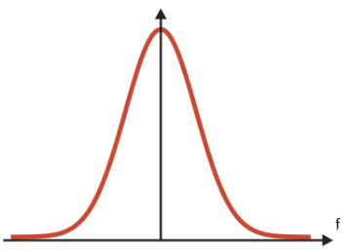
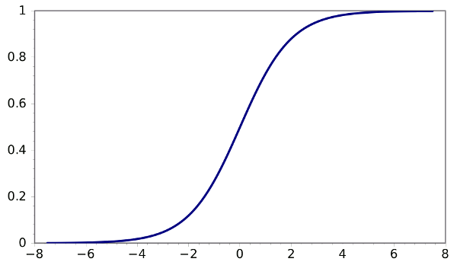
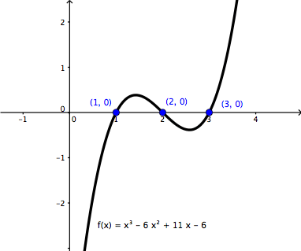
Tipo de Funciones de Kernel
$$K\left(\overset{→}{x},{\overset{→}{l}}^{i}\right)=e^{−\frac{{\left\|\overset{→}{x}−{\overset{→}{l}}^{i}\right\|}^{2}}{2σ^{2}}}$$
Kernel Gaussiano RBF
Kernel Sigmoide
$$K\left(X,Y\right)=\tanh\left(γ∙X^{T}Y+r\right)$$
Kernel Polinómico
$$K\left(X,Y\right)={\left(γ∙X^{T}Y+r\right)}^{d},γ>0$$
Notes:
The final thing you need to know is that the RBF is not the only Kernel function used in Kernel SVM.

